Slide 1
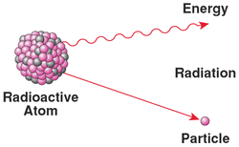
Daily Review
CFU 1
What happens to unstable isotopes?
Radioisotopes
In some isotopes, when the ratio of neutrons to protons is too high, the nucleus is unstable.
These unstable isotopes decay or change into another isotope that is more stable.
When isotopes decay, they emit particles and radiation.
Isotopes that emit radiation are called radioisotopes.
CFU 2
What is released from atoms as they decay?

Slide 2
Daily Review
CFU 1
Why does the radioactivity of a sample drop over time?
Radioactive Half-Life
As a radioactive sample decays, less and less of the original substance is left, so the radioactivity drops.
The half-life of a radioactive material, is the time taken for half of the radioactive nuclei in the sample to decay.
This is also when the radioactivity of the sample is reduced to half its original level.
CFU 2
What is the half-life of a radioactive material?
CFU 3
Iodine-131 has a half-life of 8 days. What happens to the radioactivity over that amount of time?

Slide 3
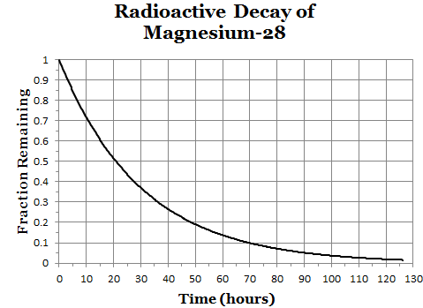
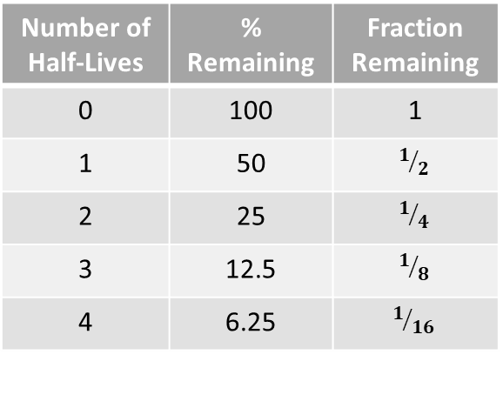
Daily Review
Number of Half-Lives | % Remaining | Fraction Remaining
0 | 100 | 1
1 | 50 | $$1/2$$
2 | 25 | $$1/4$$
3 | 12.5 | $$1/8$$
4 | 6.25 | $$1/{16}$$
Interpreting Half-Life Graphs
Use the graph to determine the half-life of the radioisotope. Calculate the number of half-lives that have passed. State the percentage or fraction of radioisotopes remaining in the sample.
What percentage of Magnesium-28 remains after 40 hours?
CFU 1
What is the half-life of the radioisotope?
The half-life of Magnesium-28 is 20 hours.
CFU 2
How many half-lives have passed?
In 40 hours, two half-lives have passed.
There would be 25% of the radioisotopes remaining.
CFU 3
What amount of the radioisotope remains?

Slide 4
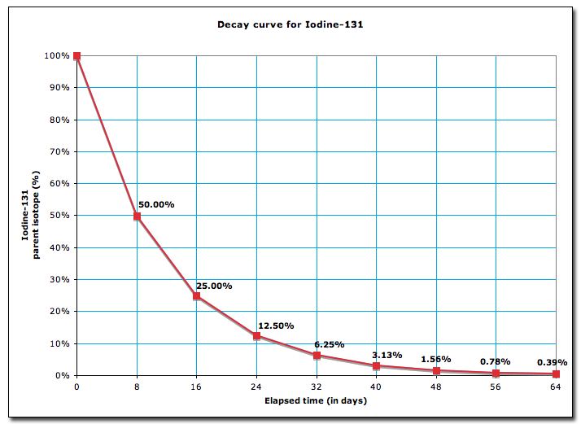
Daily Review
Number of Half-Lives | % Remaining | Fraction Remaining
0 | 100 | 1
1 | 50 | $$1/2$$
2 | 25 | $$1/4$$
3 | 12.5 | $$1/8$$
4 | 6.25 | $$1/{16}$$
Interpreting Half-Life Graphs
Use the graph to determine the half-life of the radioisotope. Calculate the number of half-lives that have passed. State the percentage or fraction of radioisotopes remaining in the sample.
What fraction of Iodine-131 remains after 8 days?
CFU 1
What is the half-life of the radioisotope?
The half-life of Iodine-131 is 8 days.
CFU 2
How many half-lives have passed?
In 8 days, one half-life has passed.
There would be ½ of the radioisotopes remaining.
CFU 3
What amount of the radioisotope remains?

Slide 5
Types of Radiation

Slide 6
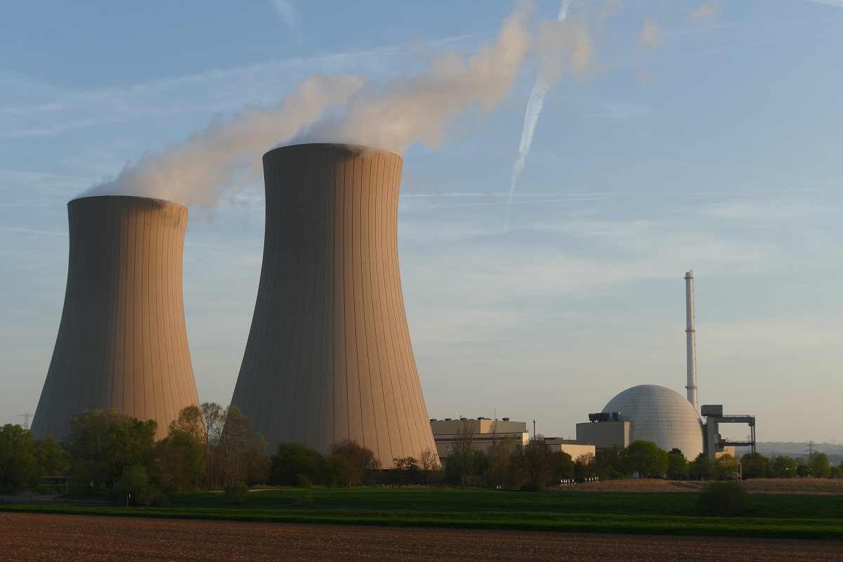
Learning Objectives
CFU
What are we going to learn?
Describe the properties of the three types of radiation produced by radioisotopes.
Activate Prior Knowledge
Materials that produce radiation have many uses.
Think-pair-share: What are some uses of radioactive materials in everyday life?

Slide 7
Concept Development
CFU 1
What is nuclear radiation?
Nuclear Radiation
Nuclear radiation describes any rays or particles emitted (released) by atomic nuclei.
There are three types of nuclear radiation that can be emitted, which are:
Alpha radiation (α)
Beta radiation (β)
Gamma radiation (γ)
These types of radiation are called ionising radiation because they can remove electrons from atoms and molecules.
Exposing cells to ionising radiation can cause them to mutate or die.
CFU 2
What can happen to cells when they are exposed to radiation?
CFU 3
What is the symbol for: Gamma radiation? Alpha radiation? Beta radiation?
Vocabulary
Nuclei: plural of nucleus

Slide 8
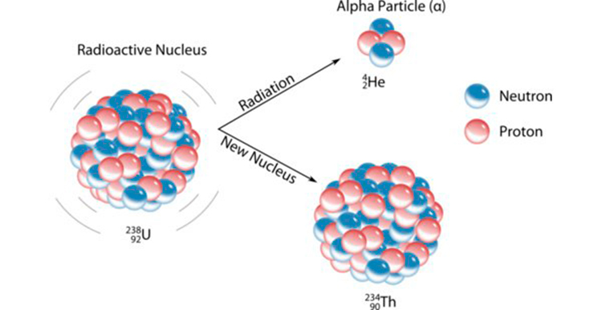
Concept Development
CFU 1
What makes up an alpha particle?
Alpha Radiation
During alpha decay, a nucleus emits an alpha particle.
An alpha particle is a group of 2 protons and 2 neutrons (the same as a helium nucleus)
Alpha decay occurs in very large nuclei, for example uranium-238 or radium-226.
CFU 2
What type of nucleus is an alpha particle the same as?
CFU 3
When does alpha decay occur?

Slide 9
Concept Development
CFU 1
What happens to the number of protons in alpha decay?
Alpha Radiation
When an alpha particle is emitted, the number of protons drops by 2, so the atom becomes a different element.
For example, uranium has 92 protons, so when it emits an alpha particle it becomes thorium, with 90 protons.
CFU 2
What happens to the element when protons are lost?

Slide 10
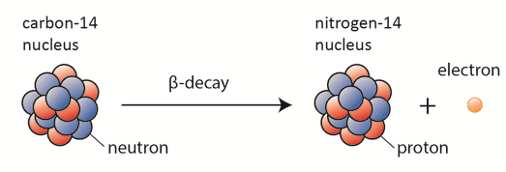
Concept Development
CFU 1
What makes up a beta particle?
Beta Radiation
During beta decay, a nucleus emits a beta particle.
A beta particle is produced when a neutron in the nucleus decays into a proton and an electron.
The electron is the beta particle that leaves the atom.
CFU 2
When does beta decay occur?

Slide 11
Concept Development
CFU 1
Why does the atom become a different element?
Beta Radiation
When a beta particle is emitted, a neutron becomes a proton, so the atomic number increases by 1, and the atom becomes a new element.
For example, carbon has 6 protons, so when it emits a beta particle it becomes nitrogen, with 7 protons.

Slide 12
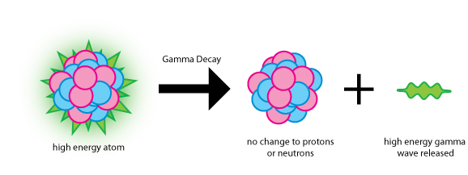
Concept Development
CFU 1
What is produced during gamma decay?
Gamma Radiation
During gamma decay, a nucleus emits gamma radiation.
Gamma rays are high-energy electromagnetic rays, similar to X-rays.
They can be emitted with alpha and beta particles, or when a nucleus rearranges itself.
CFU 2
What are gamma rays?
CFU 3
When does gamma decay occur?

Slide 13
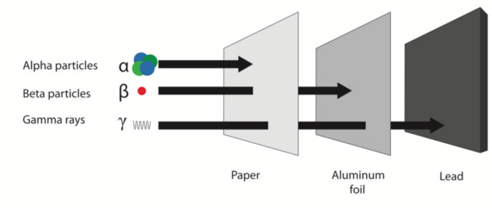
Concept Development
CFU 1
Why do alpha particles cause a lot of damage to cells?
Properties of Alpha Radiation
Alpha particles are large and slow compared to other types of radiation.
Their large size means they collide with atoms often, causing more damage (they are the most ionising form of radiation)
Their large size also means that they can only travel a few centimetres in air, and can be stopped by paper.
CFU 2
How can alpha particles be stopped, and why?
Vocabulary
Ionising radiation: radiation with enough energy to remove electrons from substances

Slide 14
Concept Development
CFU 1
Why do beta particles cause a less damage than alpha particles?
Properties of Beta Radiation
Beta particles are smaller and faster than alpha particles.
They collide with atoms often, causing some damage to cells.
As they are smaller than alpha particles, they are able to travel further through objects.
Beta particles can be stopped by a thin sheet of aluminium foil.
CFU 3
Why do beta particle travel further than alpha particles?
CFU 2
How can beta particles be stopped?
Vocabulary
Ionising radiation: radiation with enough energy to remove electrons from substances

Slide 15
Concept Development
CFU 1
How fast do gamma rays travel and why?
Properties of Gamma Radiation
Gamma rays are a form of electromagnetic radiation, so they travel at the same speed as light.
This type of radiation can pass through most objects, only a thick layer of lead or concrete will stop gamma rays.
CFU 2
How can gamma rays be stopped?
Vocabulary
Ionising radiation: radiation with enough energy to remove electrons from substances

Slide 16
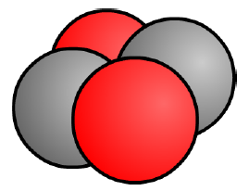
Skill Development/Guided Practice
Use the information below to complete the graphic organiser.
Alpha Particles
Draw a diagram of the particle in the first box
Mass: 4 atomic mass units (2 protons + 2 neutrons)
Charge: +2
Ionising Power: High
Penetrating Power: Low
Uses: Used in smoke alarms and for long term energy in pacemakers

Slide 17
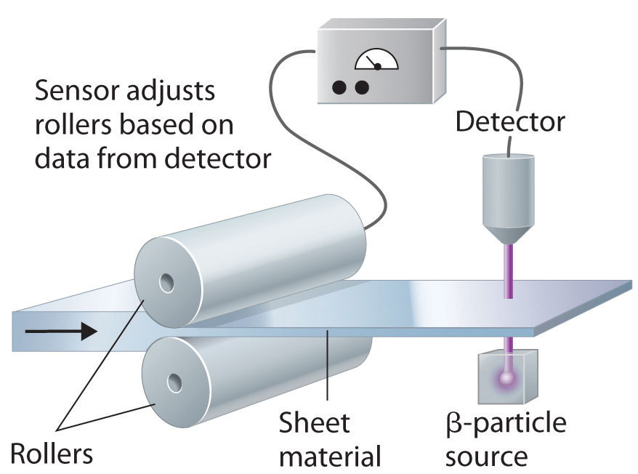
Relevance
Different types of radiation are used for different purposes. For example:
Smoke detectors and pacemakers use alpha emitters. The radiation they produce cannot travel far, so they are relatively safe to handle on a daily basis.
Beta emitters are used to measure the thickness of materials in manufacturing. A radioactive source emits beta particles, which pass through the material and can detect the thickness.
Gamma emitters are used in the treatment of cancer to kill cells and to sterilise medical equipment.

Slide 18
Skill Closure
Match the type of radiation to the particle or wave produced.
A Alpha 1 An electromagnetic wave
B Beta 2 A helium nucleus
C Gamma 3 An electron
Skill Closure
What material will stop each of the radiation types? (alpha, beta, gamma)
Skill Closure
Why is an alpha particle (a helium nucleus) more damaging to cells than a beta particle (an electron)?

Slide 19

Independent Practice
Use the information below to complete the graphic organiser.
Beta Particles
Draw a diagram of the particle in the first box
Mass: 0.0005 amu (1 electron)
Charge: -1
Ionising Power: Medium
Penetrating Power: Medium
Uses: monitor thickness of materials in manufacturing and detecting leaks in pipes
Gamma Rays
Draw a diagram of the wave in the first box
Mass: none
Charge: 0
Ionising Power: Low
Penetrating Power: High
Uses: treat cancer by killing cells and sterilise medical equipment

Slide 20
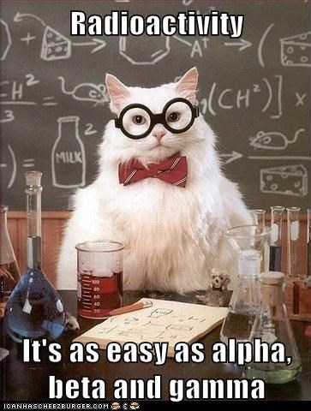
Independent Practice
Complete the text book questions on page 147.

